Slide 1
Regulating Processing of Personal Data
GDPR
Harshvardhan J. Pandit
pandith@tcd.ie | @coolharsh55
Regulating Big Tech - Utrecht Uni. | 20 December 2021 | Online/Virtual
Slides available at: https://harshp.com/research/presentations

Slide 2

Harsh(vardhan J. Pandit)
An Introduction
Postdoctoral Researcher at Trinity College Dublin, IE
Current Project: creating a knowledge graph of privacy risks for DPIA
PhD in Computer Science (2020) - Representation of activities involving personal data and consent for GDPR information
Chair of W3C Community Groups: Data Privacy Vocabularies and Controls Community Group (DPVCG) and Consent (ConsentCG)

Slide 3
GDPR¹
World-Changing EU law that regulates Processing of Personal Data
What is meant by Personal Data ?
What is meant by Processing ?
How is data is being processed? (what/how/where…)
Who is involved? (whose data, processed by whom)
How to check processing is following the rules of GDPR?
[1] https://eur-lex.europa.eu/eli/reg/2016/679/oj

Slide 4
Personal Data
GDPR

Slide 5
Personal Data
Some “definitions” from across the globe
any information that (a) can be used to identify the PII principal to whom such information relates, or (b) is or might be directly or indirectly linked to a PII principal
‘personal data’ means any information relating to an identified or identifiable natural person (‘data subject’); an identifiable natural person is one who can be identified, directly or indirectly, in particular by reference to an identifier such as a name, an identification number, location data, an online identifier or to one or more factors specific to the physical, physiological, genetic, mental, economic, cultural or social identity of that natural person;
ISO 29100:2011
“Personal information” means information that identifies, relates to, describes, is reasonably capable of being associated with, or could reasonably be linked, directly or indirectly, with a particular consumer or household.
GDPR Art.4(1)
CCPA 1798.140 (o)(1)

Slide 6
Personal Data
Identifiers, and Identifiability
Identifiers: Harsh (name), pandith@tcd.ie (email)
Non-identifiers: Black (hair), Brown (eyes), 1.66m (height), etc.
For a room full of people, combine non-identifier to uniquely identify a person (me) — thus creating an identifier !!!
Useful technique for fingerprinting, profiling, tracking

Slide 7
Q: When is Personal Data not ‘Personal’ anymore?
Ans: When it is (completely) anonymised
Anonymisation is the removal of (some) ‘identifying’ attributes from data
Merely using “anonymisation” does not produce anonymised data
It produces ‘pseudo-anonmised’ data, which is still personal data
‘Completely anonymised’ if it is not identifiable
E.g.
Your exact location = personal data
approx. house = still personal data
approx. area = still personal data, but less
City = still personal data, but lesser
Country = anonymised, kind of

Slide 8
Q: When is Anonymised Data not Anonymised?
Ans: When it is possible to ‘re-identify’ using any (practical) means possible
Data is anonymised, i.e. all identifiers like names and emails are removed
But using a ‘combination’ of remaining data points, a person is still identified
Since re-identification is possible, its not ‘fully anonymised’
‘Exploits’
Aggregated location — person’s routines are unique
Voting and voters data
Fingerprinting - browser configurations, preferences
GDPR applies to all the above since it is ‘personal data’

Slide 9
Personal Data
ISO 29184:2020
From Data Subject
Other Sources
Given
Email in forms
Inferred
Interests via website history
Observed
Public
Location via IP
ClearviewAI
Third-Party
RTB / Online Advertising

Slide 10
Personal Data: Sensitive, and Special
Special category personal data is to GDPR what Ferrero Rocher is to chocolates
Sensitive:
- data that merits additional security
- older term used widely
Special:
- requires additional/specific legal permissions
- newer term introduced in GDPR

Slide 11
GDPR Prohibits
Processing of Special Categories of Personal Data
and
Requires additional obligations via legal basis in Article. 9
racial or ethnic origin, political opinions, religious or philosophical beliefs, or trade union membership, and the processing of genetic data, biometric data for the purpose of uniquely identifying a natural person, data concerning health or data concerning a natural person’s sex life or sexual orientation shall be prohibited

Slide 12
Processing
GDPR

Slide 13
GDPR Article 4(11)
‘processing’ means any operation or set of operations which is performed on personal data or on sets of personal data, whether or not by automated means, such as collection, recording, organisation, structuring, storage, adaptation or alteration, retrieval, consultation, use, disclosure by transmission, dissemination or otherwise making available, alignment or combination, restriction, erasure or destruction;
Notable alignment with ‘common’ terms used in documents, interfaces, etc.
collect, store, use, share, delete

Slide 14
Systematic Monitoring
Evaluation & Scoring
Matching & Combining
Automated Decision Making
Innovative Use of New Technologies
GDPR Article.35 Data Protection Impact Assessments

Slide 15
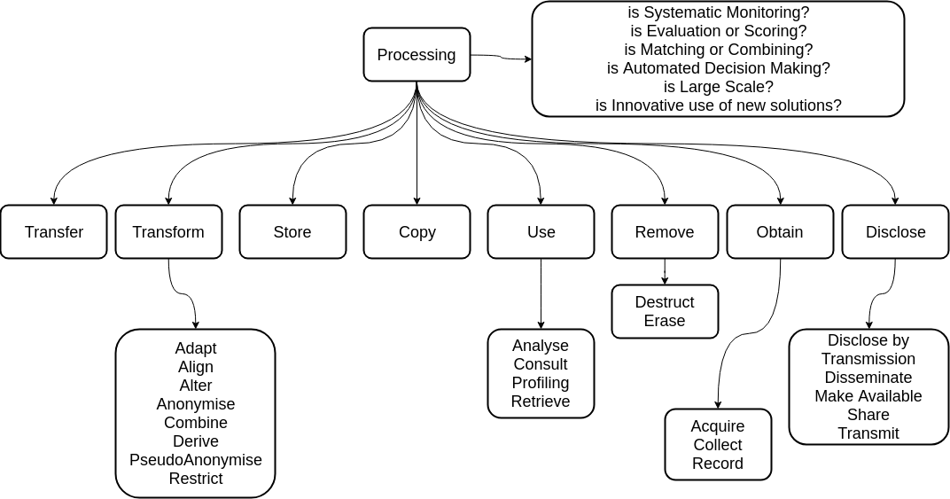
Processing Overview
Image from Data Privacy Vocabulary http://w3.org/ns/dpv

Slide 16
GDPR applies before Processing starts
Common Misinterpretations
Data collected but ‘anonymised’ is not subject to GDPR
If data isn’t shared, nothing needs to be declared
Collecting anonymised data and attaching an identifier to it
Hiding things that require transparency and permission
Scale and scope of processing
Involvement of special categories
Involvement of any automated decision making
Creating, sharing, using - profiling

Slide 17
Purpose
GDPR

Slide 18
All Processing in GDPR *must* be towards a Goal
Implied when a ‘Purpose’ is necessary as per Article.5
Purposes must be separate from other matter,
including other purposes
Every Processing *must* have a Purpose
Purposes must be *specific* and *unambiguous*

Slide 19
Purposes are intended to be human-readable and human-comprehensible
Purposes should not be broad and abstract
Purposes should be specific and contextual to their use-case
Purposes can be grouped or categorised, but not replaced, e.g. with Marketing for ‘Sending new product emails’
Purposes don’t have to necessarily benefit the data subject e.g. service optimisation

Slide 20
Actors
GDPR

Slide 21
Data Controllers are responsible for deciding the ‘purpose’
Data Controllers may not even ‘touch’ the data they ‘control’
Data Controllers can ‘team up’ to become Joint (Data) Controllers
Processors only act on ‘orders’ given (explicitly) by Controllers
Processors can appoint other (sub-)Processors, still governed by instructions from Controllers
Processors deciding/ processing on their own become Controllers
Data Protection Authorities (DPA) are empowered by GDPR to enforce its obligations on all entities
GDPR Data Interoperability Model, EURAS Annual Standardisation Conference (EURAS) 2018, Harshvardhan J. Pandit* , Declan O'Sullivan , Dave Lewis https://harshp.com/research/publications/010-gdpr-data-interoperability-model

Slide 22
Legal Basis & Principles
GDPR

Slide 23
GDPR’s Framework of Legal Basis
A.6(1-b) Contract
A.6(1-a) Consent
A.6(1-c) Legal Obligation
A.6(1-f) Legitimate Interest of Controller
A.6(1-e) Public Interest
A.6(1-f) Legitimate Interest of Third-Party
A.6(1-d) Protect vital interests of data subject or other natural person
Widespread Problematic Occurrences
A.6(1-c) Official Authority of Controller

Slide 24
GDPR's principles providing a framework for ‘responsibility'
Principles (Article.5)
lawfulness, fairness and transparency purpose limitation data minimisation accuracy storage limitation integrity and confidentiality accountability
A12-A22 Rights
Transparency (A.12)
Notice (A.13, A.14) ;
Object to Processing Rectification of Data Erasure (Right to be Forgotten) Restriction of Processing
Right of Access Data Portability
A77 Right to complaint Any Data Subject can complaint to their Supervisory Authority (DPA) If DPA is in a different country than the company, then the DPA will ‘lease’ and ‘co-operate’ with the DPA of that country
Consent (Article.7)
Informed Freely Given
Unambiguous Balance of Power(s) Right to Withdraw
Explicit Consent (e.g. for Article.9)

Slide 25
Investigating ‘Personal Data Handling’
GDPR

Slide 26
Step 1: Identify concepts for the use-case

Slide 27
Step 2: Compare against requirements
Who is it? Singular? Joint controllers?
Special Categories of Personal Data?
Categories? Any relation to Controller? Minors? Vulnerable?
Scale? Automated? Profiling?
Specific? Contextual? Sensible?
Shared with whom? Why? Relevant to Purpose? In EU?
Correct for use-case? Alternatives? Which is ‘best’?
Consent? Fulfils requirements for ‘valid consent’???
Notice / Privacy Policy / Rights exercising

Slide 28
Break (10 mins)
We’ll be back here at 12:00 CET

Slide 29
What does BigTech do for GDPR??? Lets’ find out!
We’ll take a quick look at notices and policies by
GAFAM = Google, Apple, Facebook, Amazon, Microsoft

Slide 30
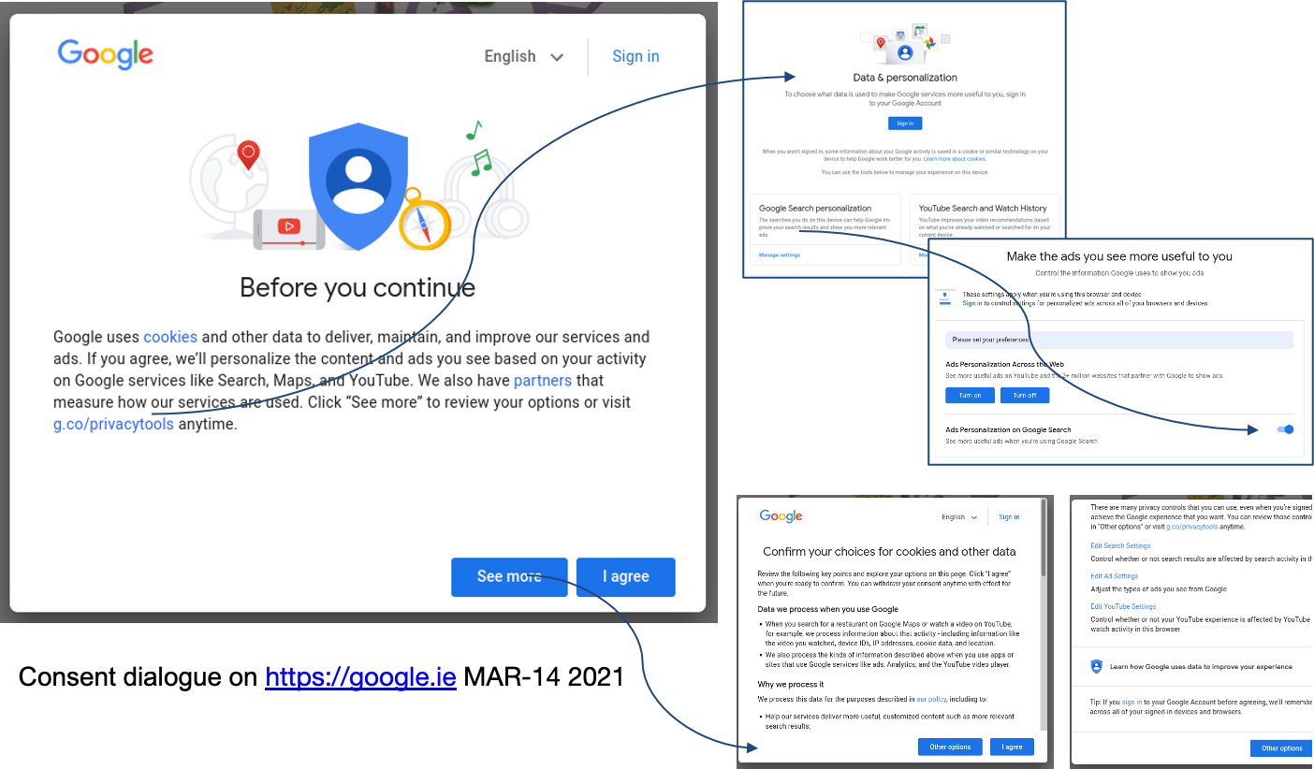
Companies are required to show you a “NOTICE” informing what data they collect and how they use it.
Where this is based on your CONSENT, they need to ask your permission before they can proceed.
Since every website visit collects and uses your personal data, this means there’s a notice & consent process every time you visit a website …
2
3
9
1
How many clicks to “Accept” ==> 1
10
How many clicks to “Reject” ==> 3
How many clicks to “Truly Reject” ==> 12
Do you think this is:
LEGAL ?
ETHICAL ?
NECESSARY ?
Google
11
12

Slide 31
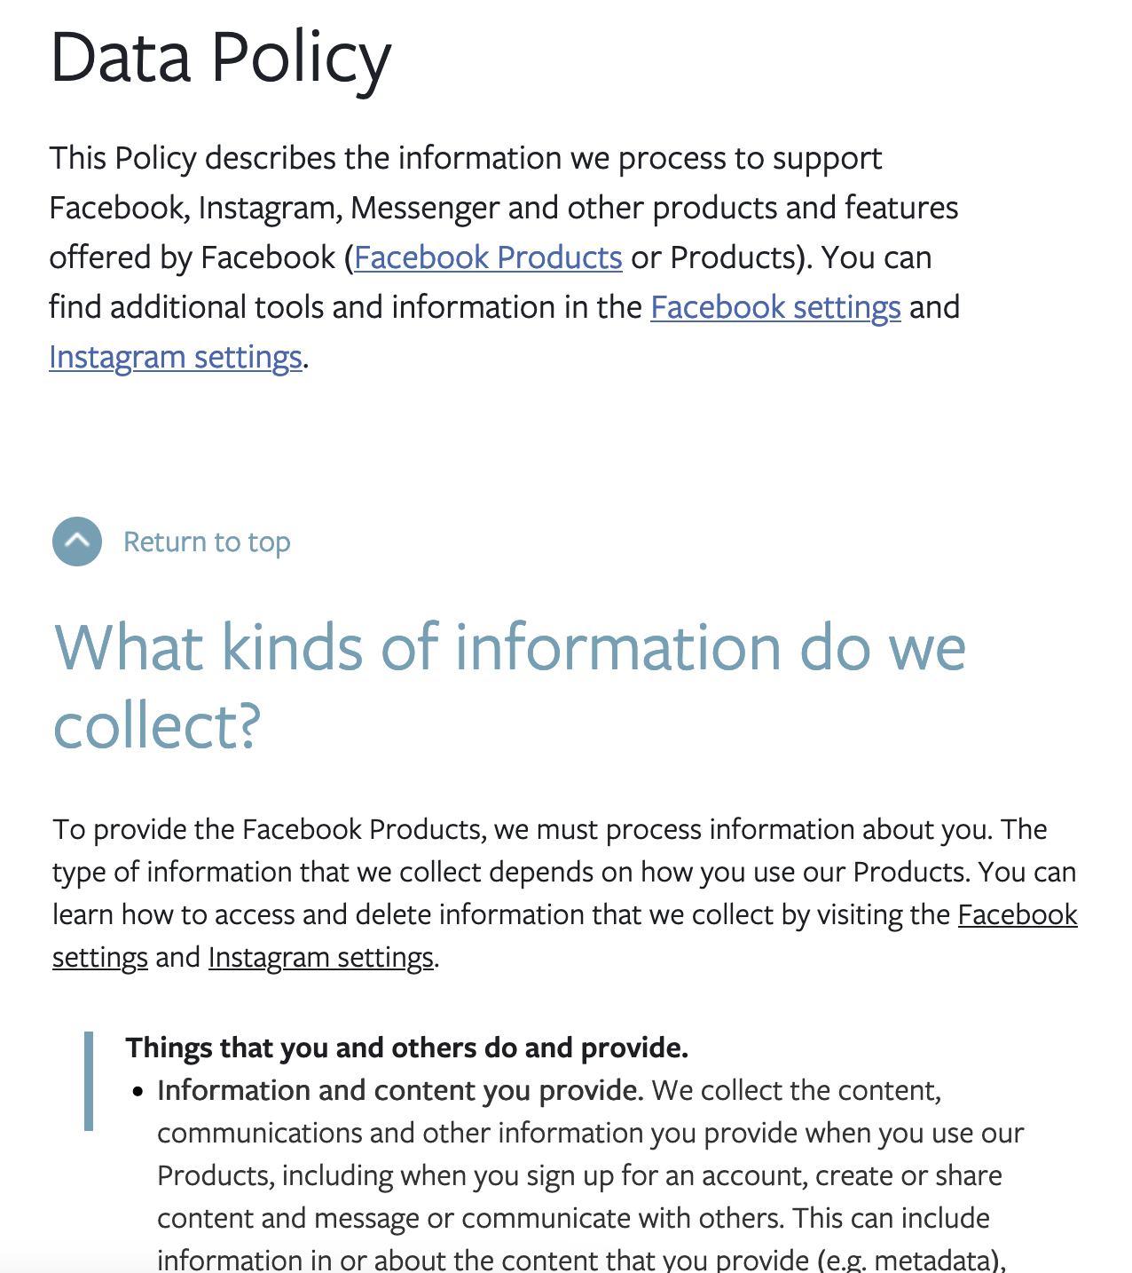
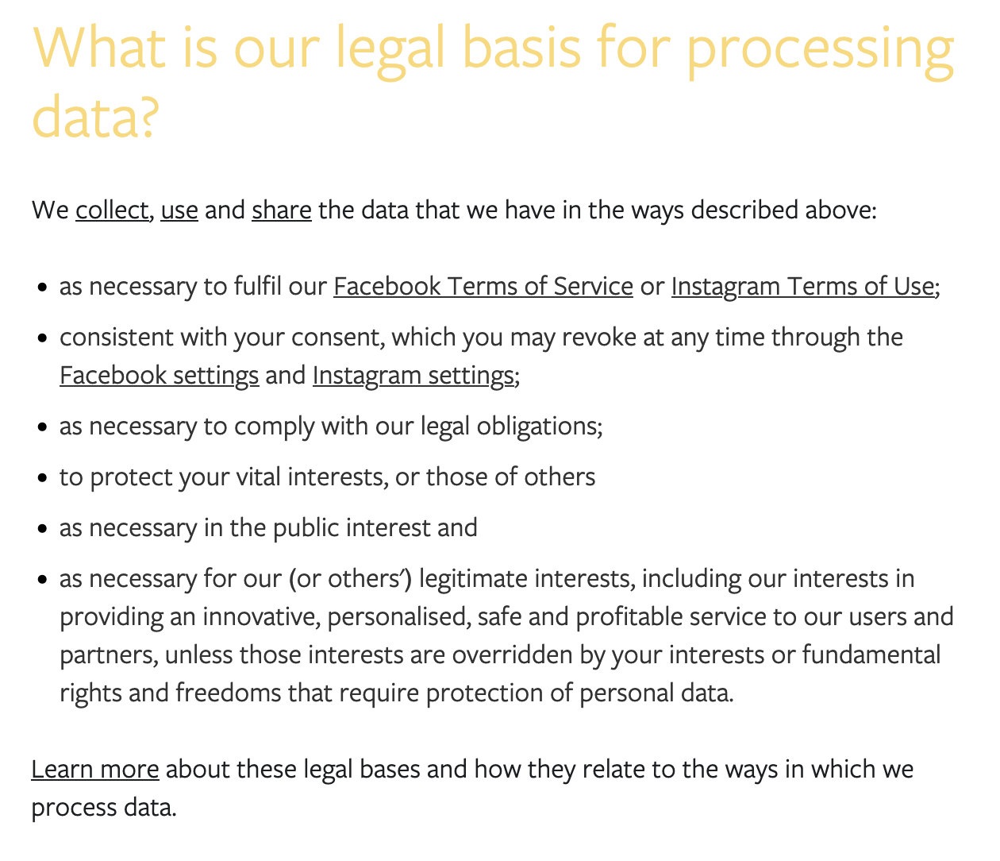
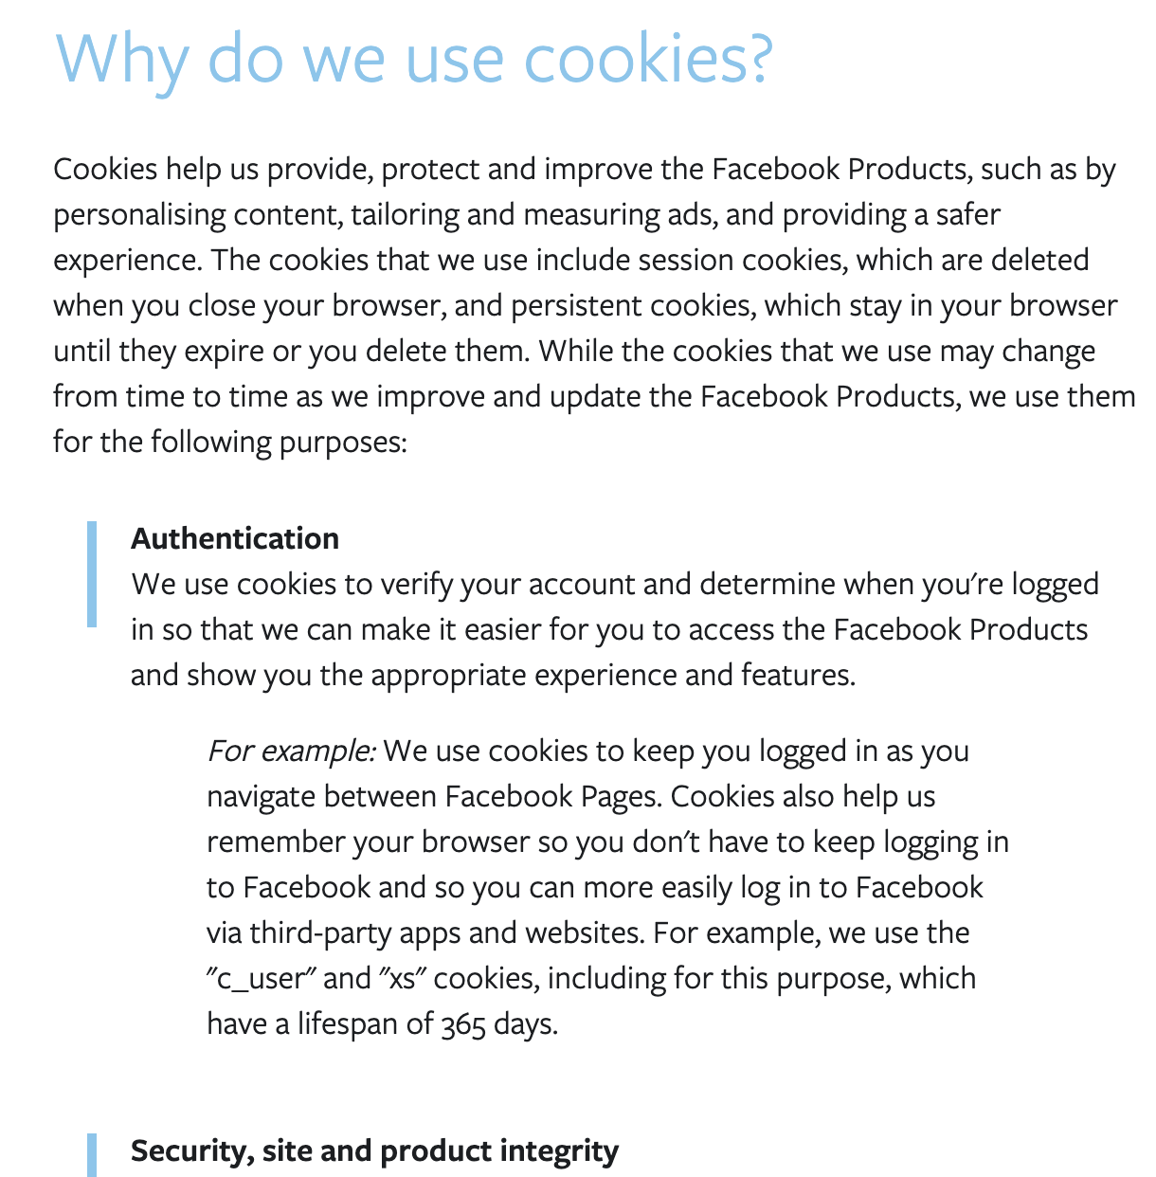
Facebook
https://www.facebook.com/legal/terms/update
https://www.facebook.com/about/privacy/update
Note: Ongoing case with Irish Data Protection Authority filed by Max Schrems (NOYB) regarding whether the legal basis (contract) used by Facebook is the correct one to be used under GDPR. The basic argument is, Facebook claims personalised advertising is a necessary part of providing a social network service and what the users accept when they agree to the terms and conditions.

Slide 32
What am I working on?
Privacy Risks, GDPR, Legal Compliance, Semantics

Slide 33
Machine-Readable Metadata for Automated Approaches
Data Privacy Vocabulary (DPV), v0.3, 2021 https://w3.org/ns/dpv

Slide 34
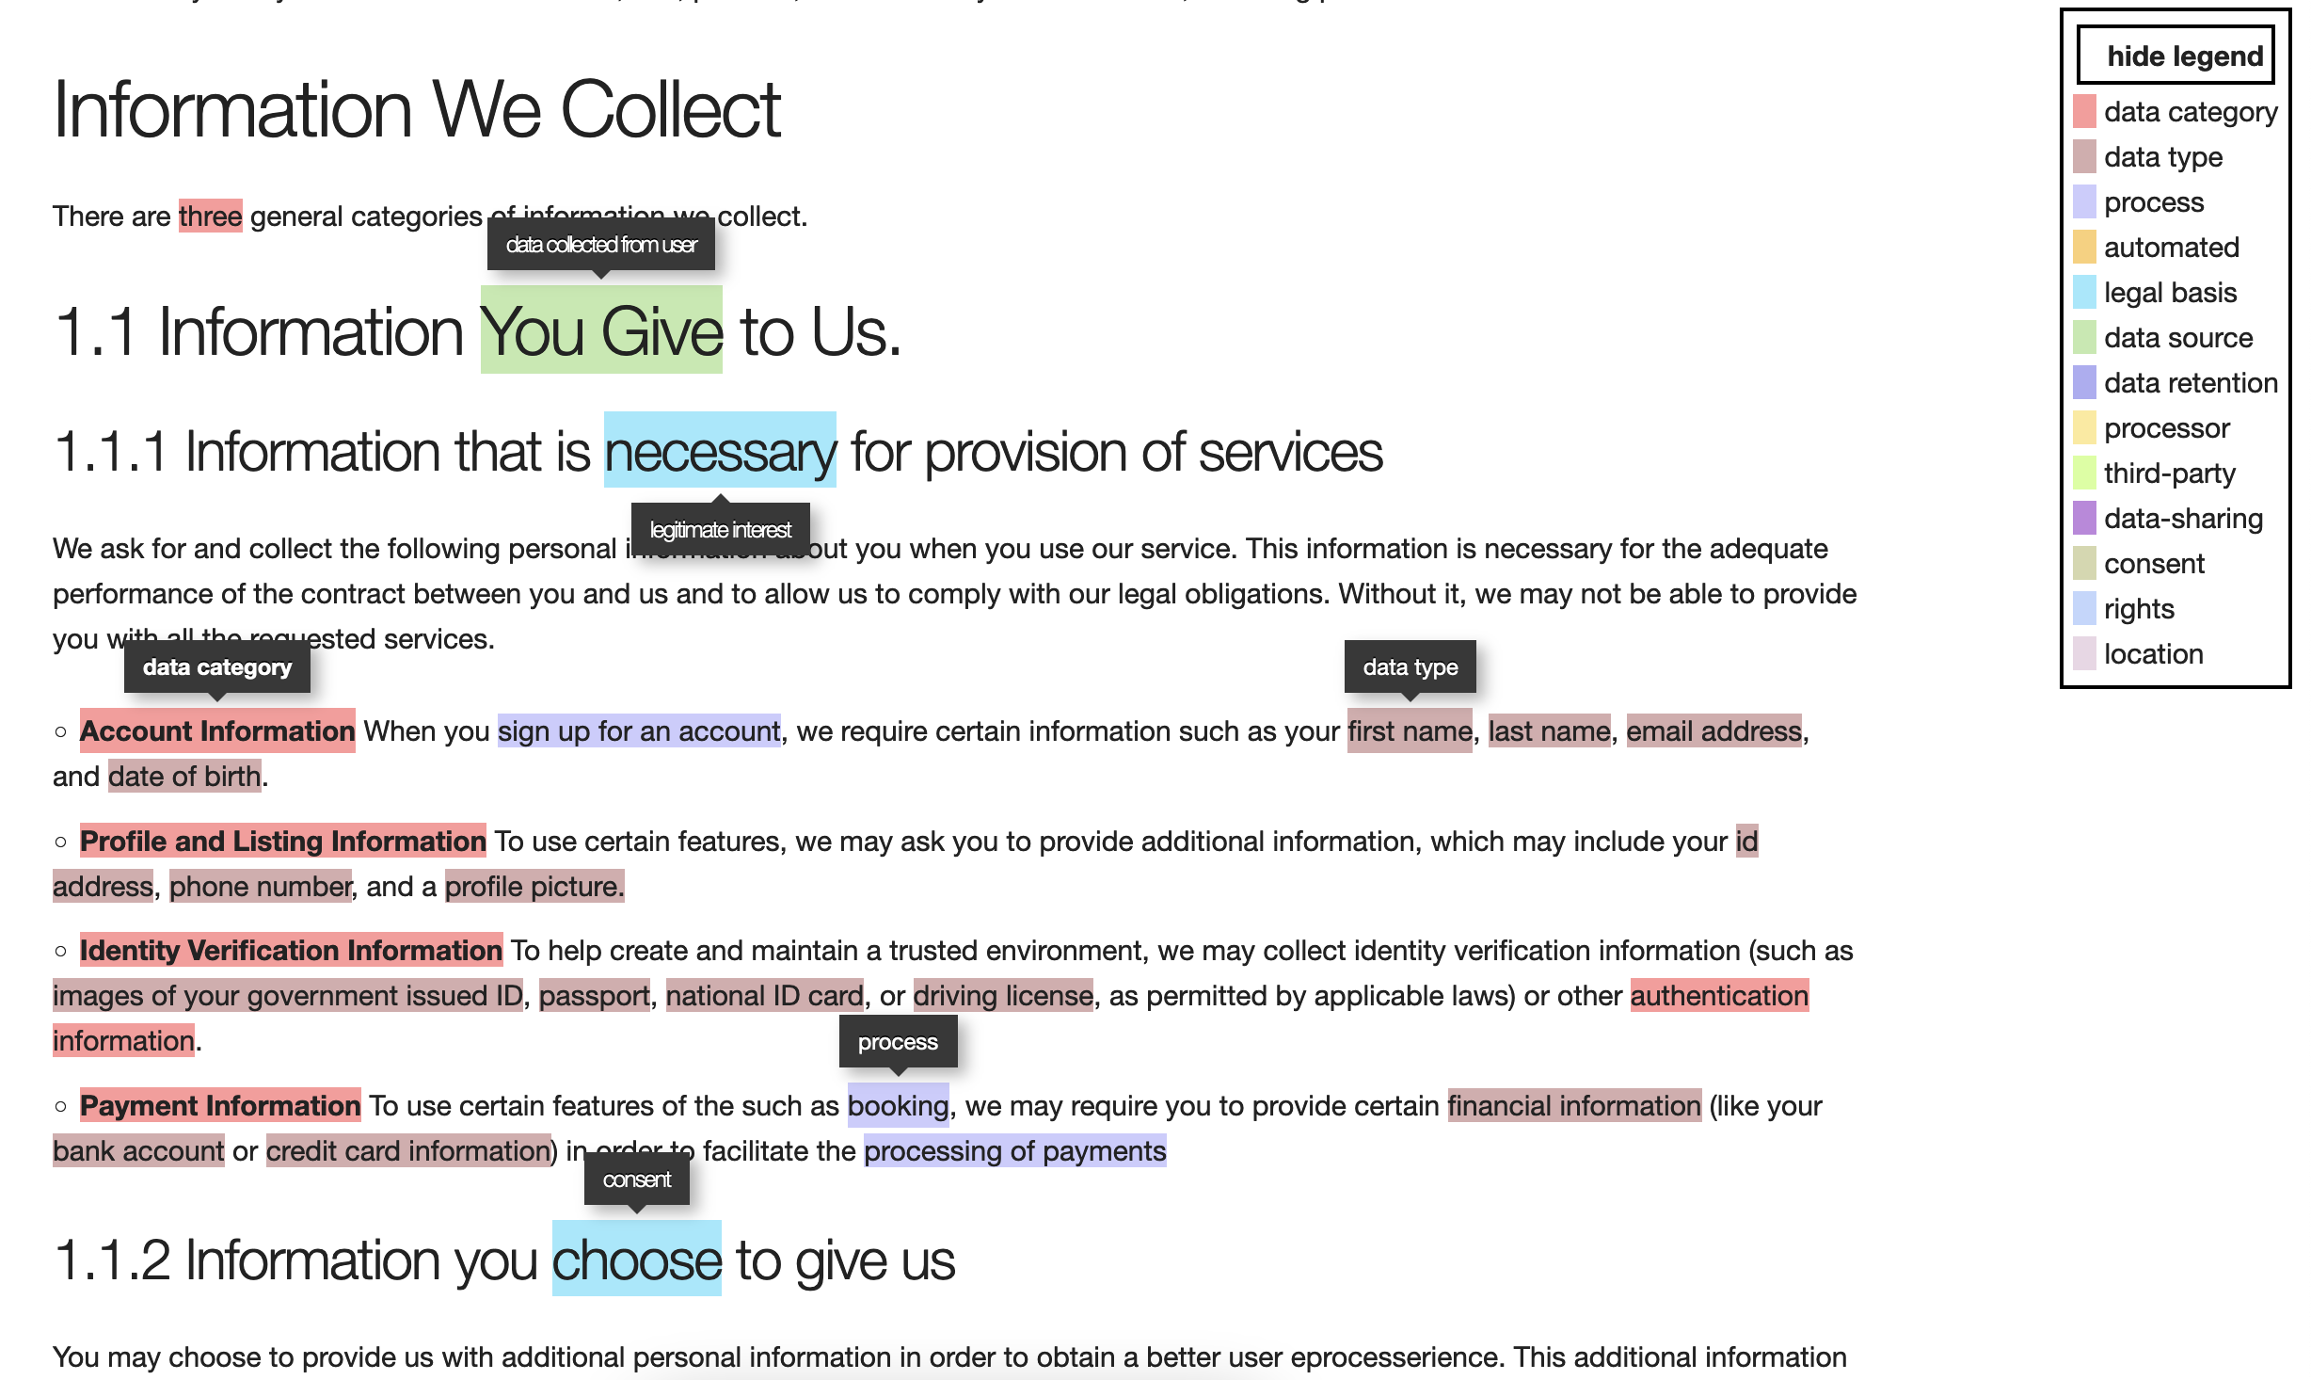
Real-World Use-Cases
Privacy Policy Analysis
https://openscience.adaptcentre.ie/privacy-policy/personalise/demo/policy.html

Slide 35
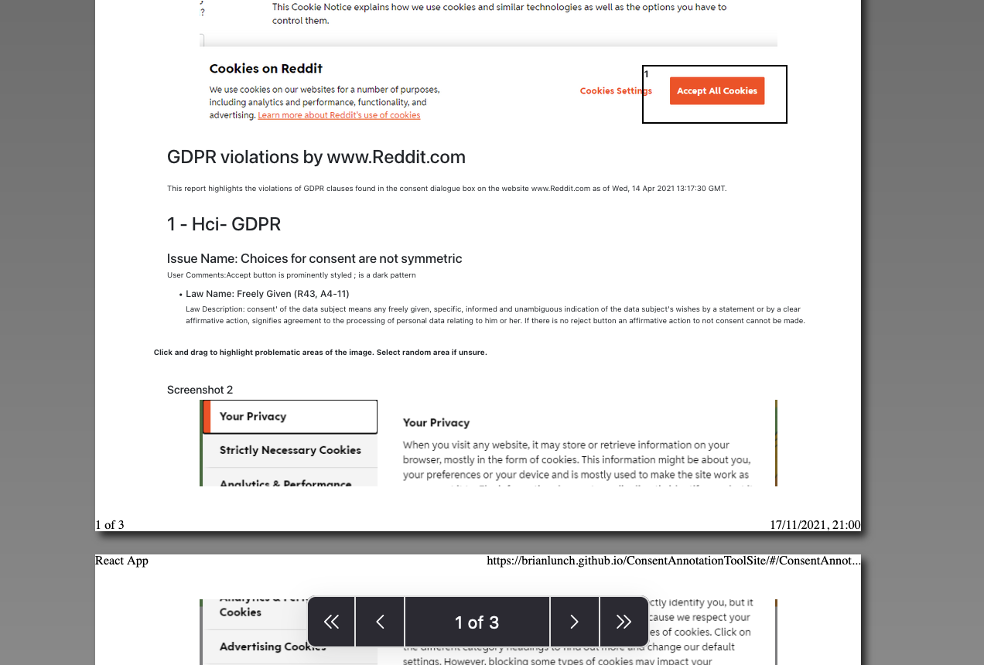
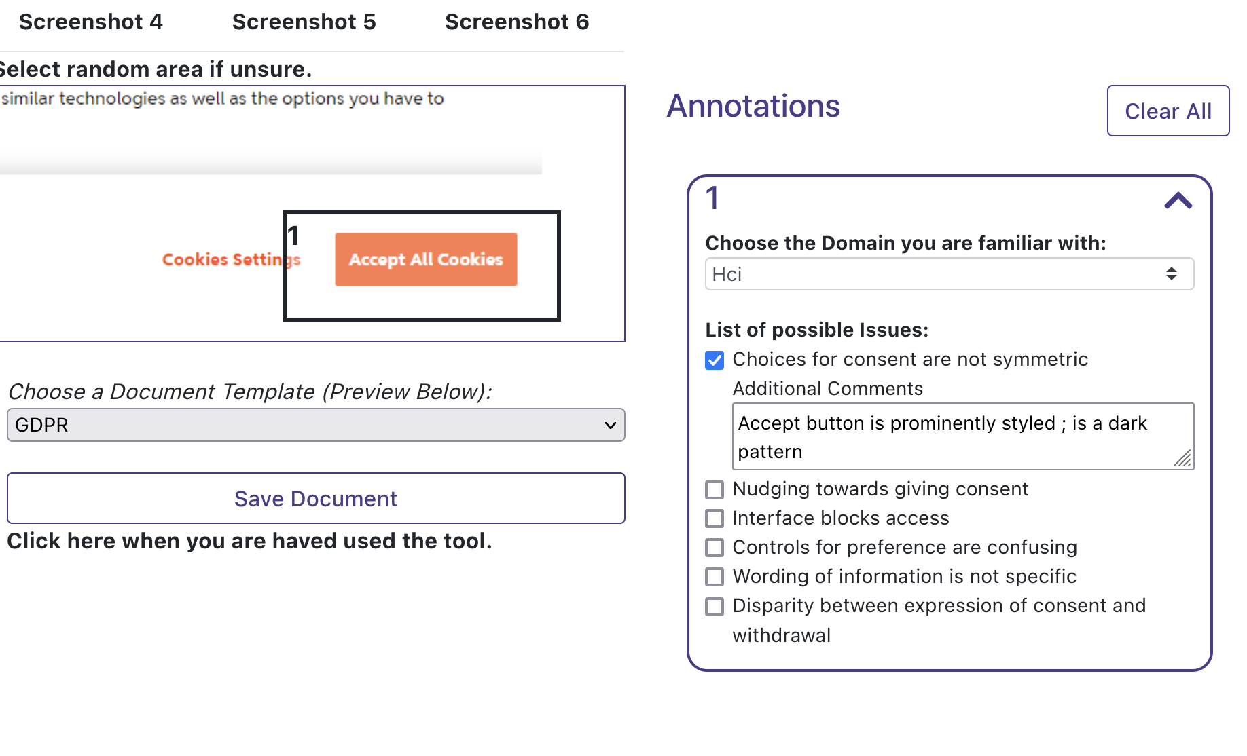
How to Complaint Better?
Making it easier to report, investigate, document, and resolve issues online
https://brianlunch.github.io/ConsentAnnotationToolSite/#/study/

Slide 36
Regulating Processing of Personal Data
GDPR
Harshvardhan J. Pandit
pandith@tcd.ie | @coolharsh55
Regulating Big Tech - Utrecht Uni. | 20 December 2021 | Online/Virtual
Slides available at: https://harshp.com/research/presentations

